Slide 1
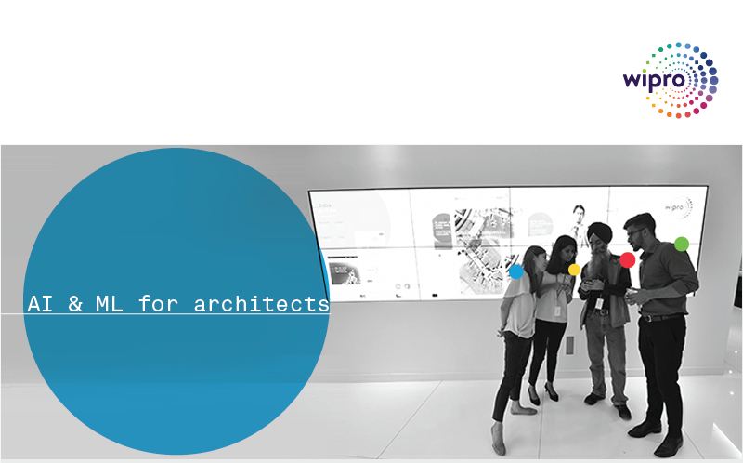
Introduction to AI and ML Gururajan Narasimhan Erode

Slide 2
Agenda
Introduction to Artificial Intelligence – AI
Human actions corresponding AI actions - What constitutes AI
Strong AI and weak AI – Introduction and examples
Introduction to Machine Learning and the idea of Learning
Overview of Neural Networks and its role in AI
Complete Machine Learning cycle
Supervised and Unsupervised learning
Semi-supervised learning and Reinforcement learning
Machine Learning techniques and algorithms
Neural Networks and Deep Learning

Slide 3
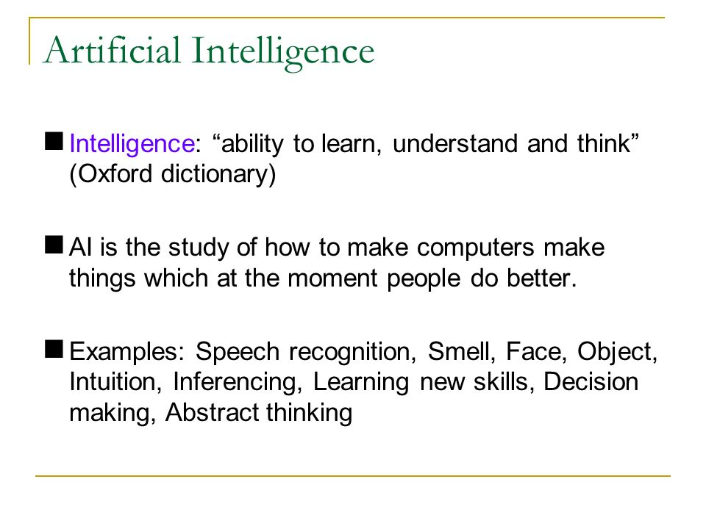

Slide 4
Artificial Intelligence
Humans
Computers
We see
We speak and we listen to other people speak
We read from a given text, understand and write text
We smell
We touch, move and run
We think, reason, make decisions in real time based on current inputs and experience, learn, extract useful information from data, perform cognitive functions such as problem solving,
We feel
Computer Vision
Speech recognition / voice recognition
Natural Language Processing (NLP)
Nothing still, may be possible
Kinematics and robotics
General AI – just starting
Nothing still, is it really possible?

Slide 5
Artificial Intelligence – General Intelligence – Strong AI – Broad AI
Machines that mimic the cognitive functions that humans associate with other human minds, such as “complete learning” and “problem solving”.
This is Strong AI or Full AI
General AI or Full AI is the complete cognitive abilities and decision making sensory range of properties that human’s have.
Nobody in the world has successfully make products in General AI, the likes of – think Arnold Schwarzenegger in terminator or Chitti in Robot 1

Slide 6
Artificial Intelligence - Examples of Applied AI – Weak AI – Narrow AI
Domain specific chat bots like the Wipro's helpline or in general any immigration help system
Amazon’s recommendation Engine
deep blue the first computer based chess playing champion
The Advanced Driver Assistance Systems (ADAS)

Slide 7
Artificial Intelligence - Examples of Applied AI – Weak AI – Narrow AI
Amazon’s “echo dot” and “echo plus” voice recognition systems
NEST home connectivity startup acquired by google in 2014
Pandora Internet Radio is a music streaming service and automated music recommendation service powered by the Music Genome Project
Deep mind of google is now in Applied AI, but they want to keep their mind on General AI as well https://deepmind.com/about/

Slide 8
Artificial Neural Networks and Deep Learning
An artificial neuron network (ANN) is a computational model based on the structure and functions of biological neural networks. Information that flows through the network affects the structure of the ANN because a neural network changes - or learns, in a sense - based on that input and output.
ANNs are considered nonlinear statistical data modeling tools where the complex relationships between inputs and outputs are modeled or patterns are found. ANN is also known as a neural network.
Deep learning is the technology that uses neural networks where there are more than two hidden layers

Slide 9
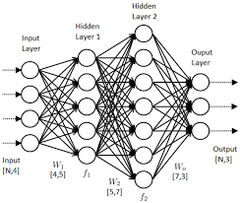

Slide 11
What is Machine Learning – Tom Mitchell
The field of machine learning is concerned with the question of how to construct computer programs that automatically improve with or LEARN from experience
Tom M. Mitchell provided a widely quoted and more formal definition of the algorithms studied in the machine learning field: "A computer program is said to learn from experience E with respect to some class of tasks T and performance measure P if its performance at tasks in T, as measured by P, improves with experience E. … “
The key word here is Learning
What do mean by saying “ I am Learning”
The ability to understand and improve my work based on previous experience

Slide 12
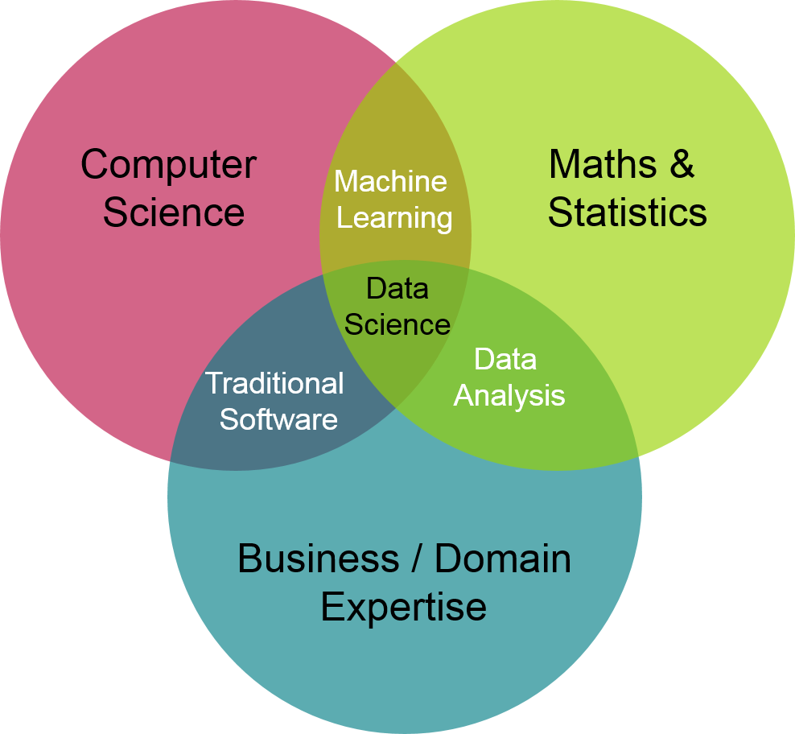
https://ion.icaew.com/itcounts/b/weblog/posts/theaccountinganddatascienceworldsmeet

Slide 13
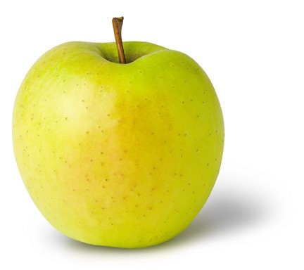
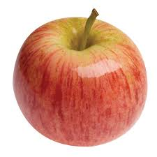

Learning (Training)
y = f(x)
output
prediction function
Image feature
Features:
1. Color: Radish/Red
2. Type : Fruit
3. Texture : Soft
4. Shape
etc…
Features:
1. Sky Blue
2. Logo:
3. Texture :
4.Shape
etc…
Features:
1. Yellow
2. Fruit
3. Texture : Soft
4.Shape
etc…
What do you mean by Apple?

Slide 14
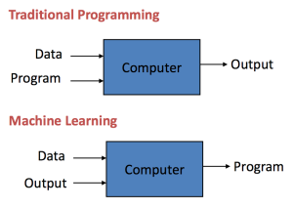

Slide 15
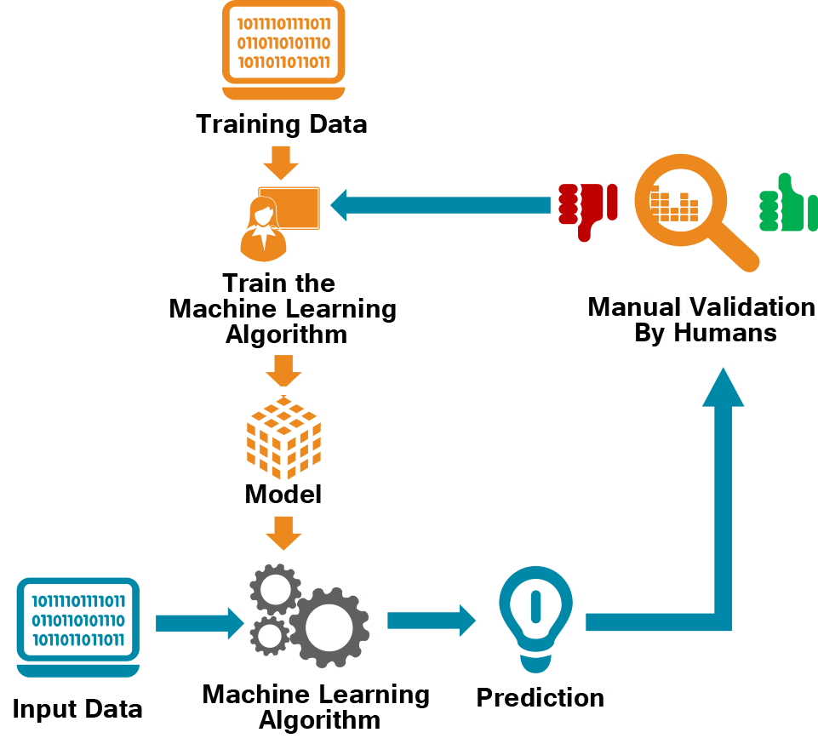

Slide 16
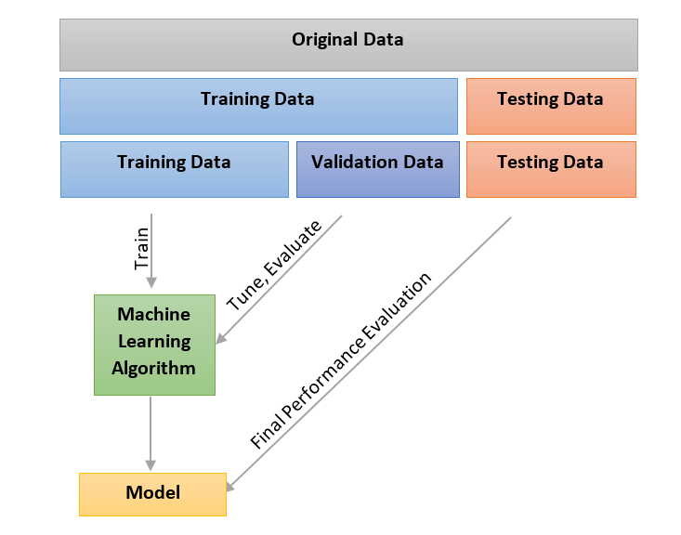

Slide 17
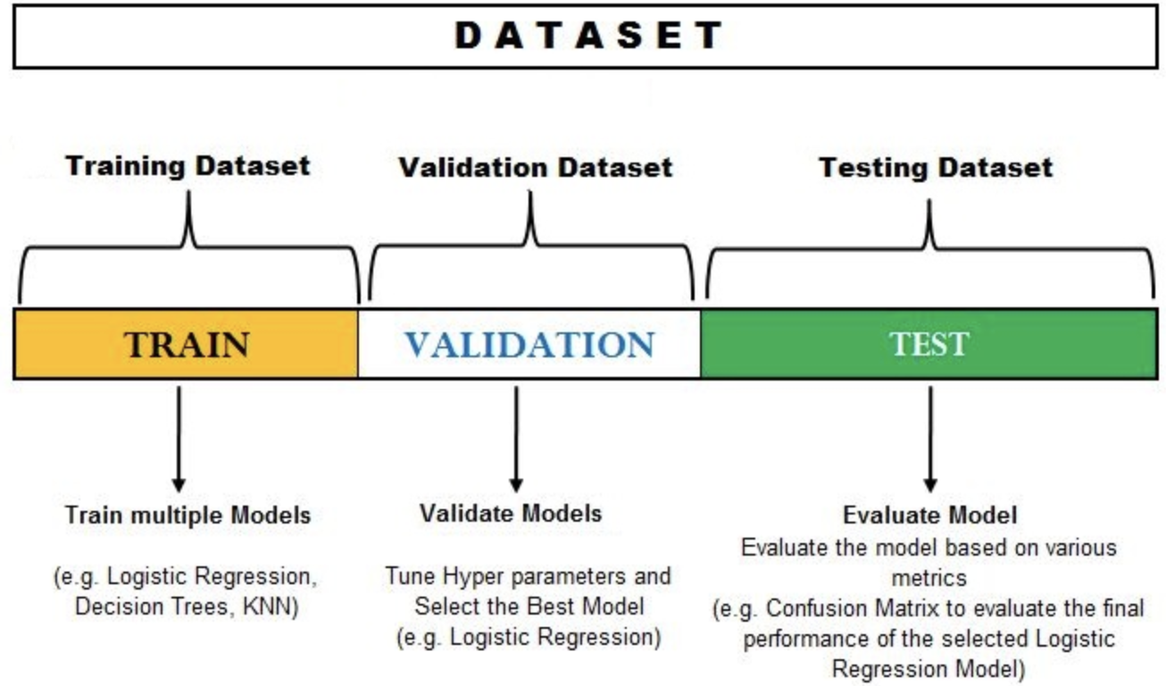

Slide 18
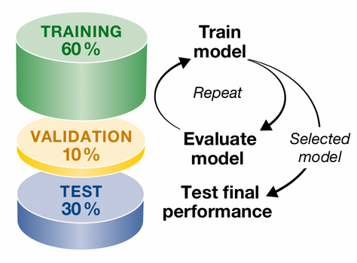

Slide 19
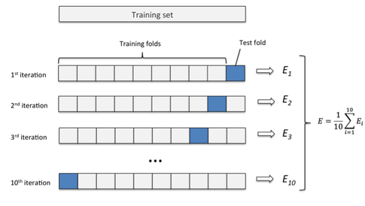

Slide 20


Slide 21
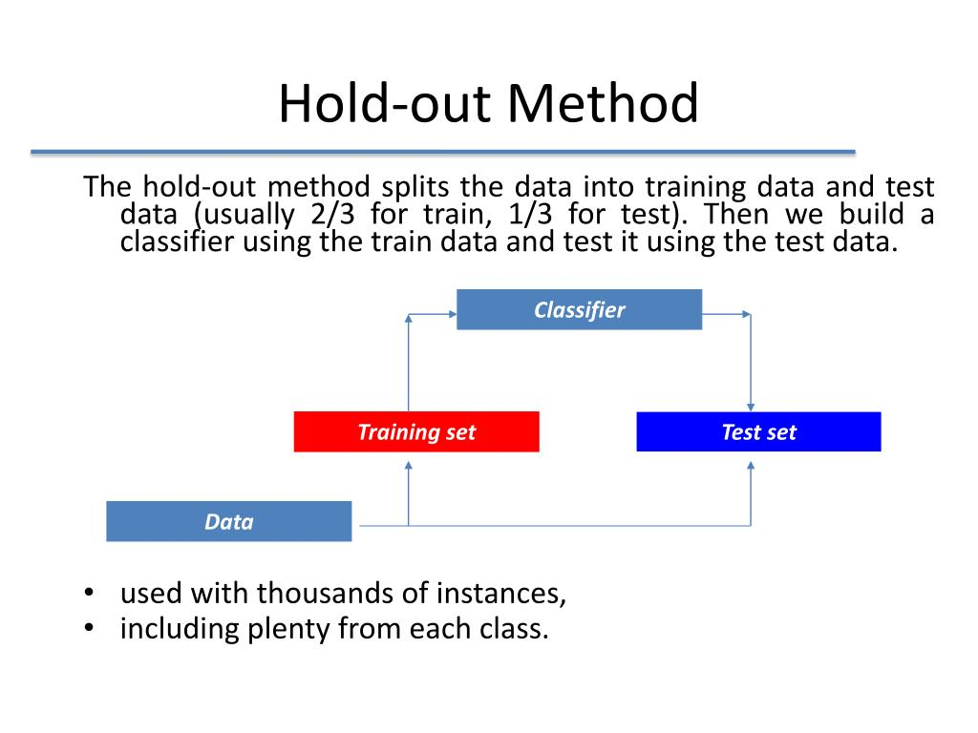

Slide 22
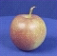
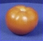
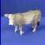
The machine learning framework
Apply a prediction function to a feature representation of the image to get the desired output:
f( ) = “ apple”
f( ) = “ tomato”
f( ) = “ cow”
Training: given a training set of labeled examples {(x₁,y₁), …, (x_{N},y_{N})}, estimate the prediction function f by minimizing the prediction error on the training set
Testing: apply f to a never before seen test example x and output the predicted value y = f(x)
Slide credit: L. Lazebnik

Slide 23
What is what in ML
In machine learning the pictures or words or actual numbers are the – DATA – this is ‘x’ the input variable
The names you gave for those pictures – LABELS or OUTPUT -- labeled output
Program writing in Python, R or C++ -- LEARNING ALGORITHM -- this is the program you write in python
The equations which you have built – the model of an apple you have in mind - MODEL – The model is also the function “ f “
Then when a real apple is then shown to you, then you say it is an apple, this is the PREDICTED OUTPUT – ‘ y’

Slide 24
Machine Learning - Terminology
Features
The number of features or distinct traits that can be used to describe each item in a quantitative manner
Samples
A sample is an item to process (e.g. classify). It can be a document, a picture, a sound, a video, a row in database or CSV file, or whatever you can describe with a fixed set of quantitative traits.
Feature vector
is an n-dimensional vector of numerical features that represent some object.
Feature extraction
Preparation of feature vector
transforms the data in the high-dimensional space to a space of fewer dimensions.
Training/Evolution set
Set of data to discover potentially predictive relationships.

Slide 25
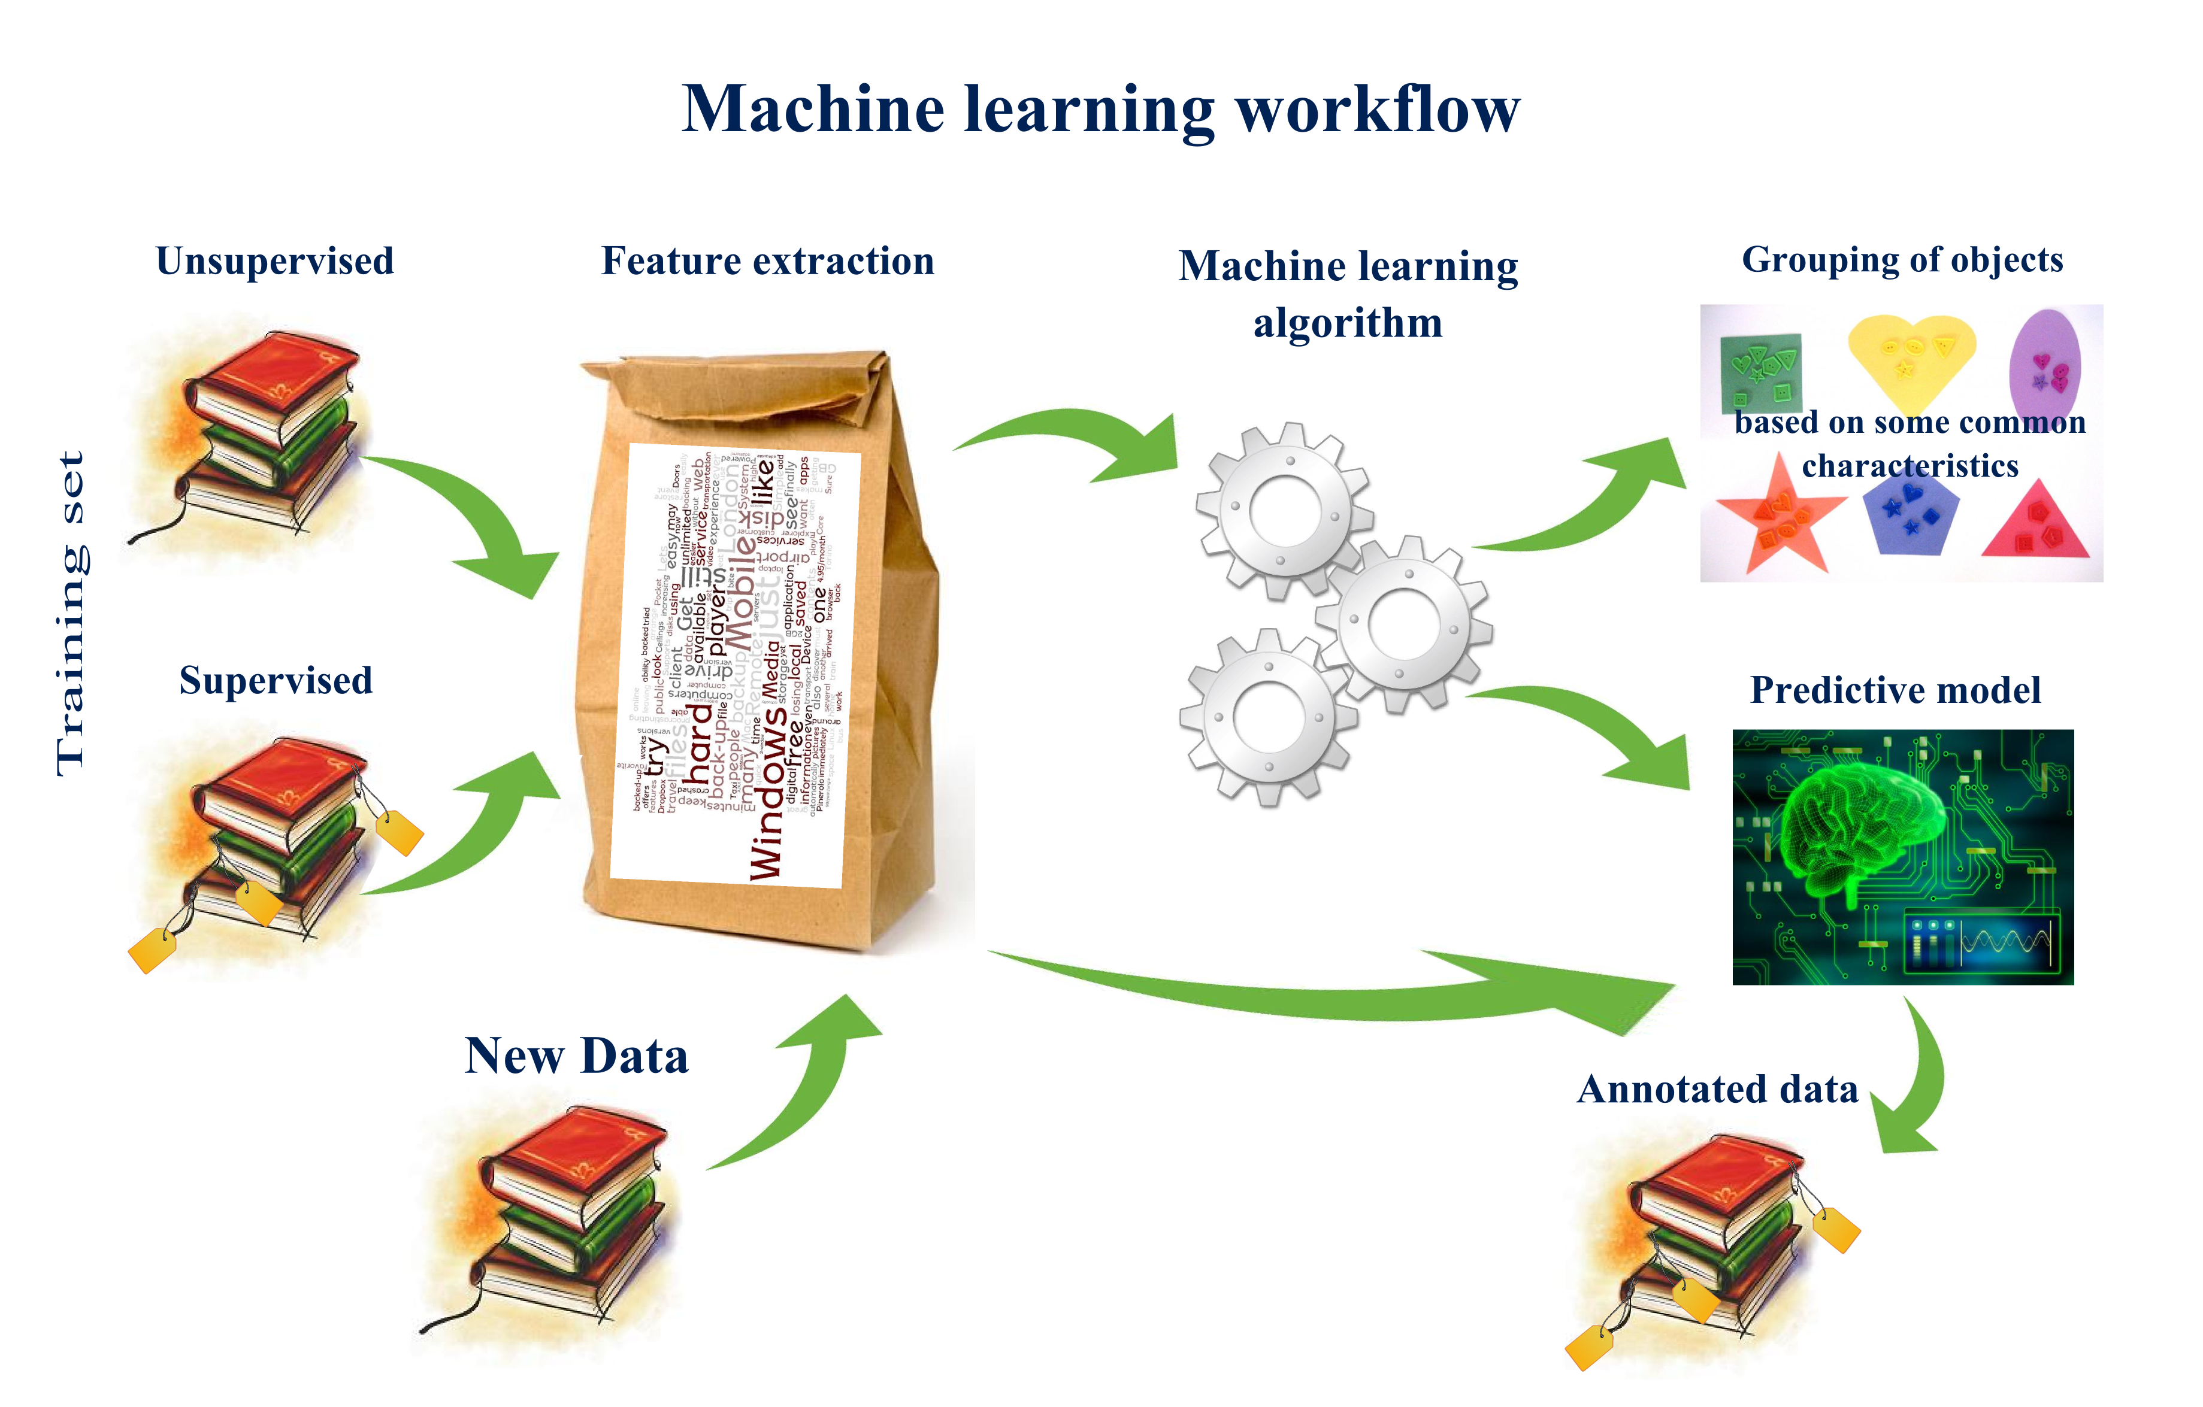

Slide 26

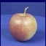
Machine Learning – How it is done?
Training
Training Labels
Training Images
Image Features
Training
Learned model
Testing
Image Features
Learned model
Prediction
Test Image
Slide credit: D. Hoiem and L. Lazebnik

Slide 27
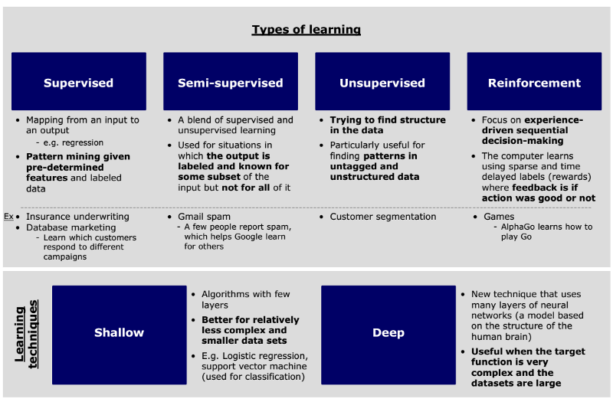
http://sungsoo.github.io/2017/03/28/three-things-you-need-to-know-about-machine-learning.html

Slide 28
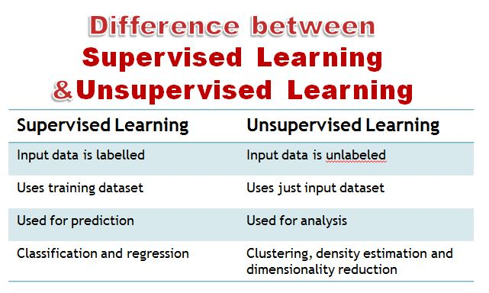

Slide 29
Supervised Learning
Supervised learning is the machine learning task of inferring a function from labeled training data. The training data consist of a set of training examples.
In supervised learning, each example is a pair consisting of an input object (typically a vector) and a desired output value (also called the supervisory signal)

Slide 30
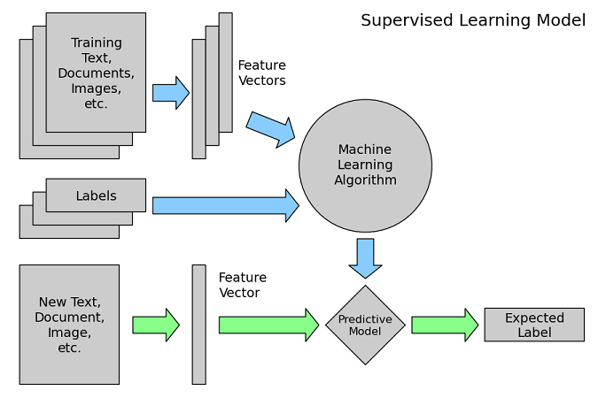

Slide 31
Unsupervised Learning
Unsupervised learning is a type of machine learning algorithm used to draw inferences from datasets consisting of input data without labeled responses.
The most common unsupervised learning method is cluster analysis, which is used for exploratory data analysis to find hidden patterns or grouping in data.

Slide 32
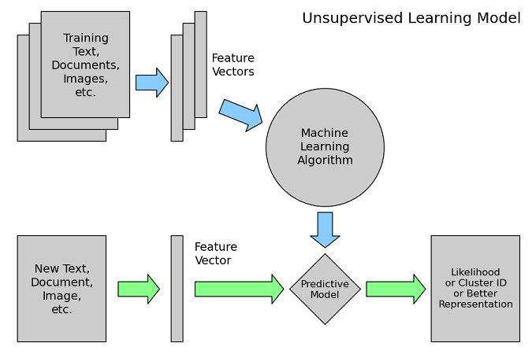

Slide 33
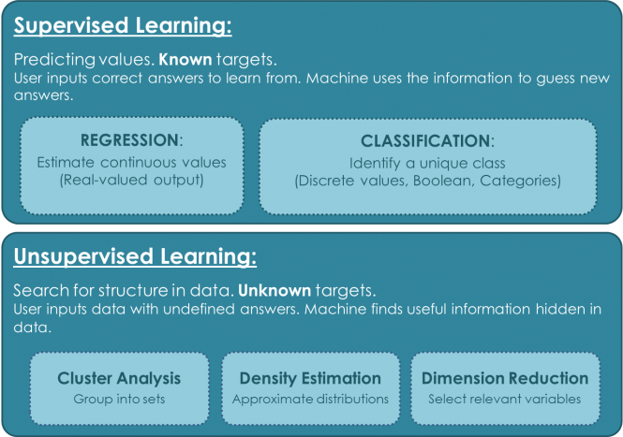

Slide 34
Semi-Supervised Learning
Semi-supervised learning is a class of supervised learning tasks and techniques that also make use of unlabeled data for training – typically a small amount of labeled data with a large amount of unlabeled data

Slide 35
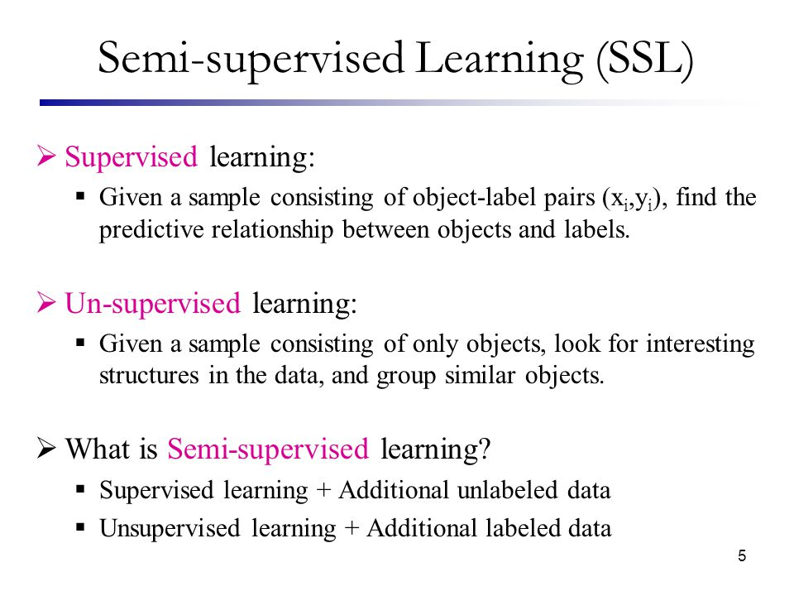

Slide 36
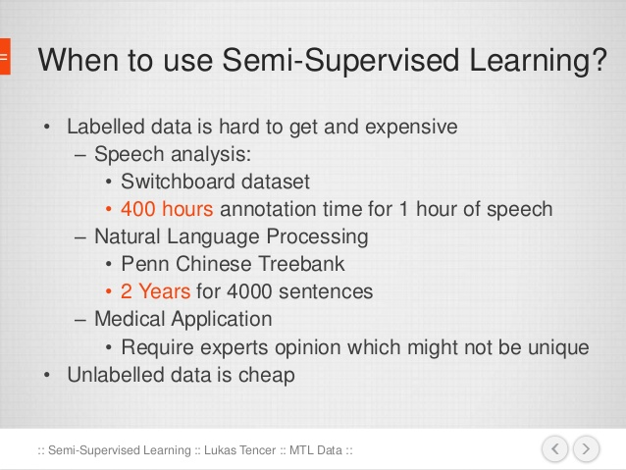

Slide 37
Reinforcement Learning
Reinforcement learning, in the context of artificial intelligence, is a type of dynamic programming that trains algorithms using a system of reward and punishment.
A reinforcement learning algorithm, or agent, learns by interacting with its environment. The agent receives rewards by performing correctly and penalties for performing incorrectly. The agent learns without intervention from a human by maximizing its reward and minimizing its penalty.

Slide 38
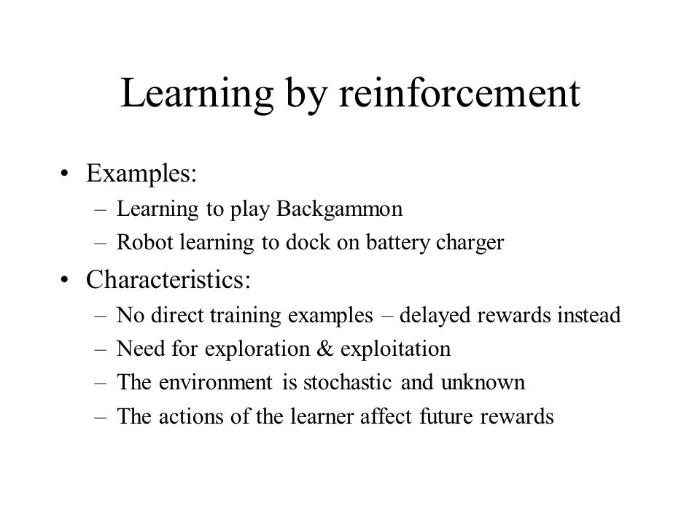

Slide 39
